Slide 1


HEALTH CARE DOMAIN

Slide 2
About Team
Sunitha Devi Koneti | John Mahith | MitraBhanu Panda
MCA | B.Tech (CSE) | B.Tech (Electrical Engineering)
I have around one and half years of experience as a Test Engineer. I just want to update myself with the new technology, that is the reason I have chosen Data Science. | The Final Project “Fake News Detection” through Data Science Application Made him Got interested in how the Data Science work in the real world. | As Data Science is a booming Technology, He wants to explore it and enhance his knowledge with Data Science.

Slide 3
Summary of The Data
The Size of the data is 1338 * 7
age: age of primary beneficiary
sex: insurance contractor gender Male/Female
bmi:Body mass index, providing an understanding of body, weights that are relatively high or low relative to height, objective index of body weight (kg / m ^ 2) using the ratio of height to weight, ideally 18.5 to 24.9
children: Number of dependents
smoker: Smoking
region: the beneficiary's residential area in the US, northeast, southeast, southwest, northwest.
charges: Individual medical costs billed by health insurance

Slide 4
Exploratory Data Analysis
Various Types Of EDA
Bivariate
Multivariate
UNIVARIATE
BIVARIATE
Univariate
Numerical
Categorical
Num
Vs
Num
Num
Vs
Cat
Cat
Vs
Cat

Slide 5
Data Cleaning Steps
Checked whether the column names and it’s Data Types are correct.
There we didn’t find any incorrect column names and it’s datatypes in this dataset.
Checking For missing values in each column.
We didn’t find any missing values in this data set.
We have 4 numerical and 3 categorical columns in this data set.
charges is target Variable in this dataset.

Slide 6
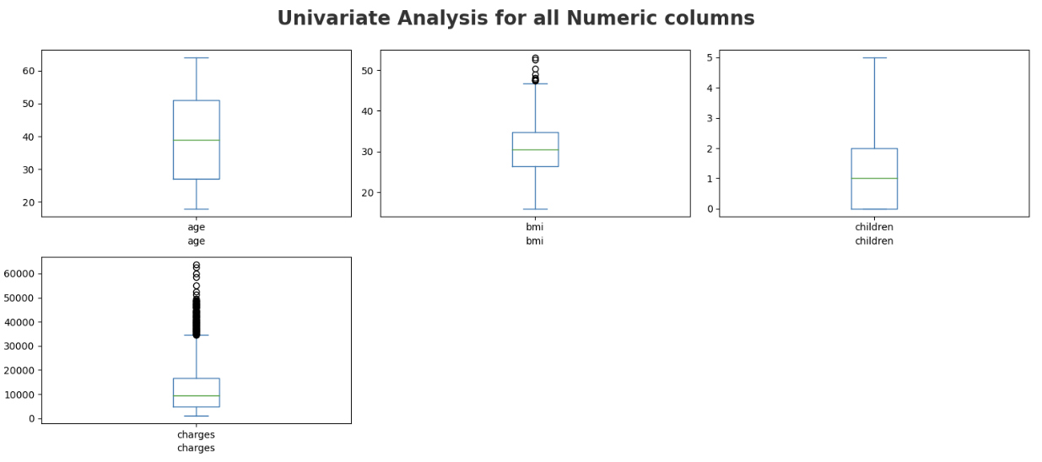
Outlier Detection On Numerical Variables
Box plot is use to detect the outliers in the columns.
We can find the outliers in bmi and charges.
We treated outliers using 1.5 IQR .
As Charges is Target Variable, Before going to treat we need to think in domain perspective.

Slide 7
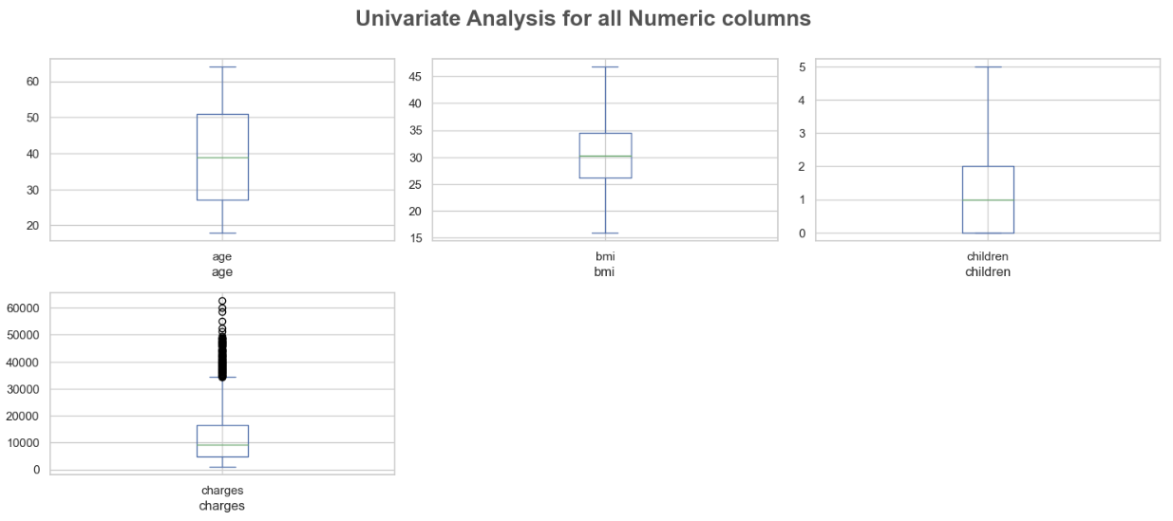
After Treating Outliers in bmi
By treating Outliers in bmi, 9 datapoints were removed.
Outliers are not just the outliers but excellent signals of new trends.
If domain knowledge allows the outliers exist, we can keep them.

Slide 8
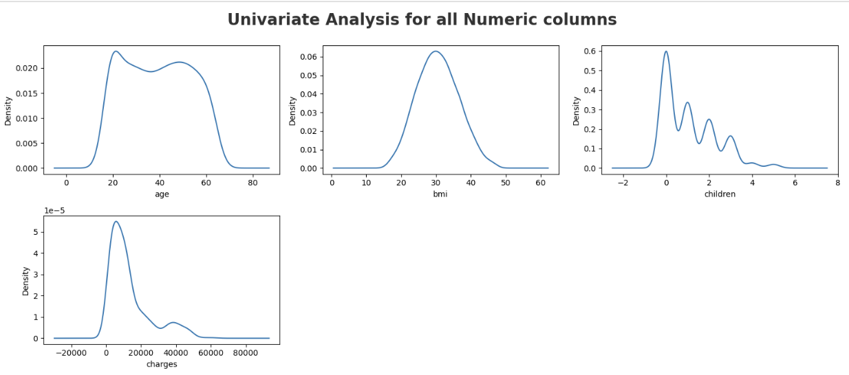
Distribution Of All Numeric Columns
Age group has almost symmetric curve, but having some discrepancies in the peek of the bell shaped curve.
Bmi has normal distribution .
Children column has 4 peeks so it is called multimodel.
Charges have pareto distribution. Understanding the distribution of charges using the Pareto distribution can help policymakers and insurers analyze and manage the financial aspects of healthcare more effectively. 80% of project’s benefit comes from 20% of the work.

Slide 9
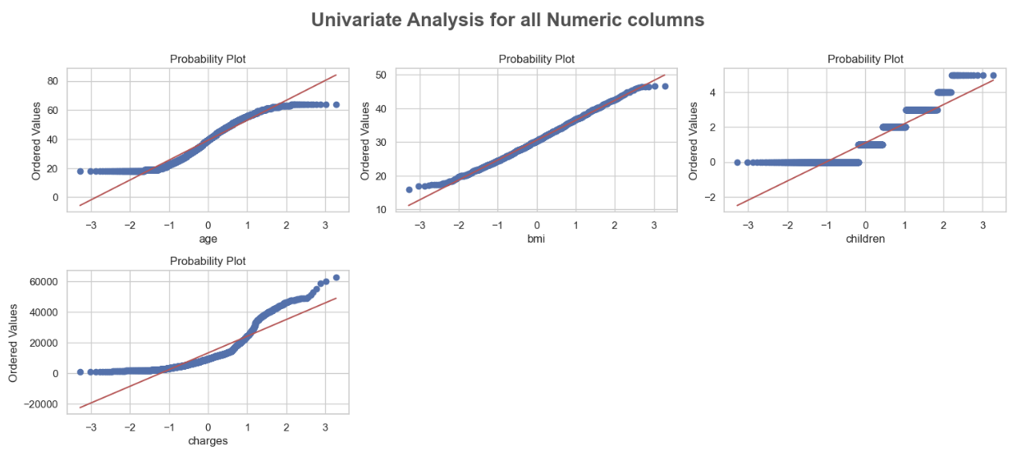
Verifying Distribution of Numeric Columns
Except bmi, remaining three features doesn’t follow normal distribution.

Slide 10
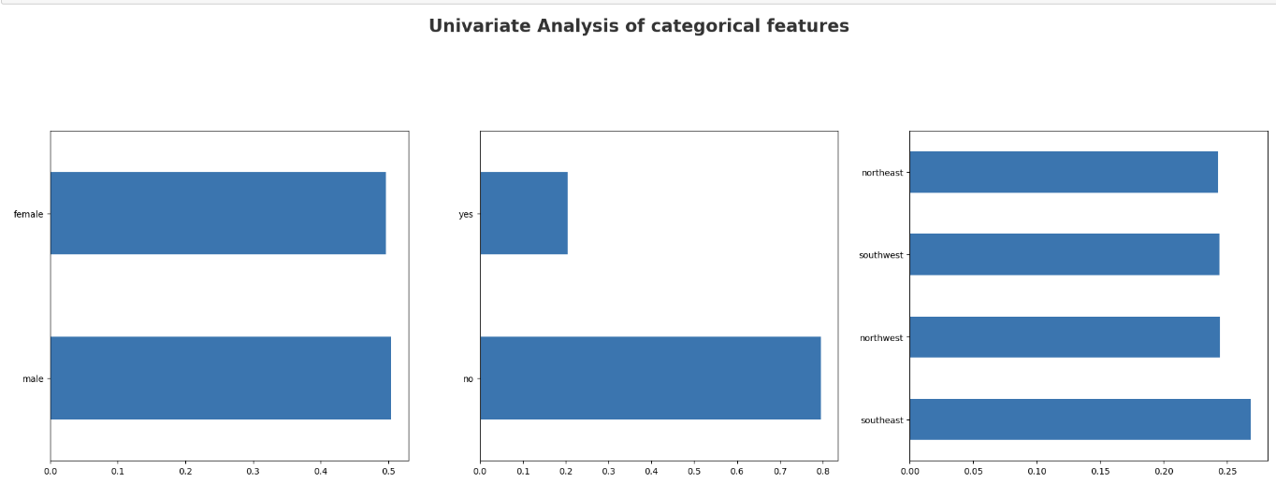
Categorical Columns
There is not much difference in female and male members.
Comparative Non Smokers, smokers are very less in count.
Except Southeast region, remaining three are almost same in count. The members from southeast were more in count.

Slide 11
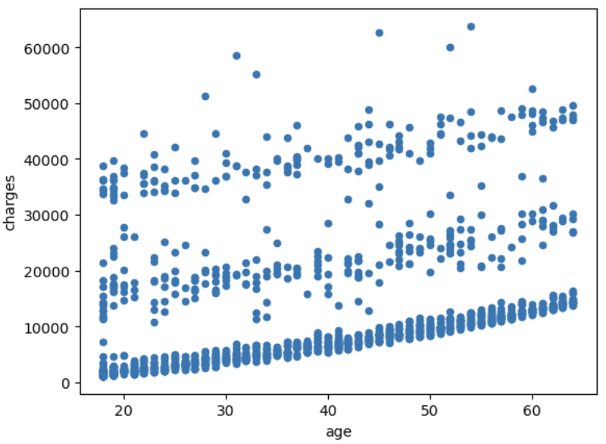
Age Vs Charges
This data set includes all age groups. As age is increasing the medical expenses are also increasing.
At the Same time The patients who have less age also have more medical expenses .
So we can not say that only particular group has More medical expenses.
That is the reason we have observed almost symmetric curve.

Slide 12
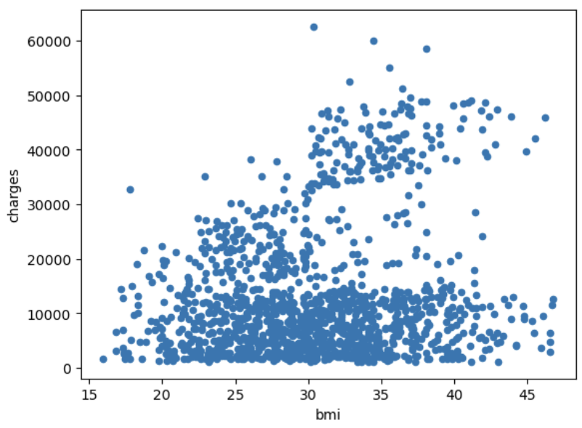
Bmi Vs Charges
The patient who has BMI more than 25.0 and less than 50.0 has more medical expenses in the data set.
But technically those who are having 50 BMI can be considered as higher risk patients.
But in our data the patients those who have 50 BMI might be athletes with fit muscle weight or there may be any reason, those doesn’t have much medical expenses. This could be the reason, we are finding outliers in this feature.
The patients who have BMI less than 18.5 also have higher medical expenses because of underweight.

Slide 13
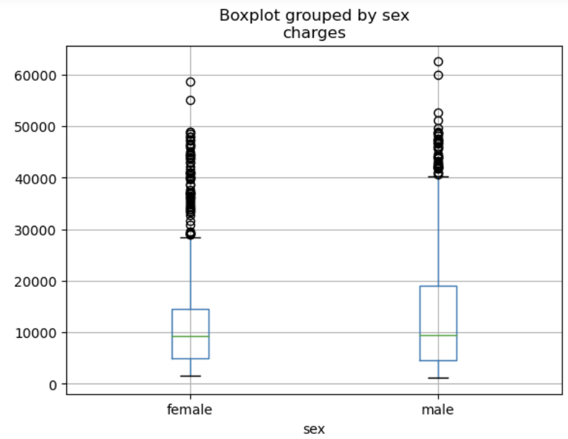
Gender Vs Charges
Gender(sex) has an impact on charges. The number of males and females are almost same but female patients have higher medical expenses than male.

Slide 14
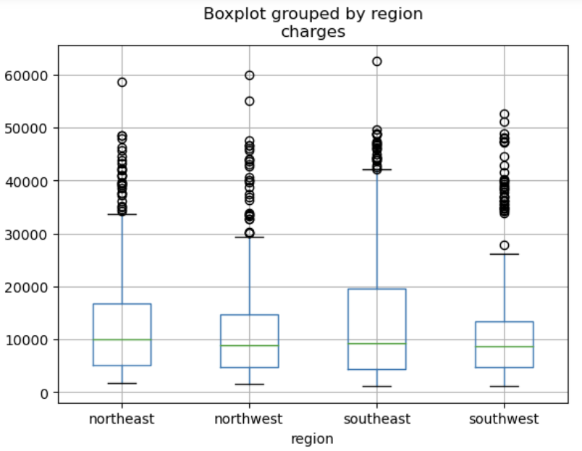
region Vs charges
The southeast region has more medical expenses than the other three regions.
The remaining three regions have almost similar medical expenses.

Slide 15
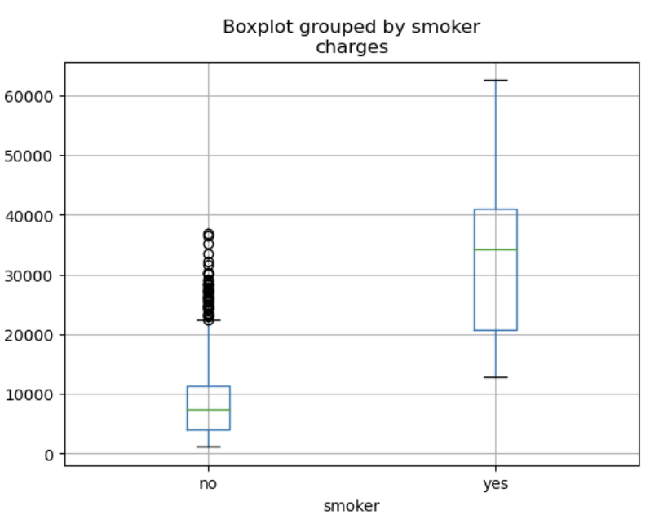
Smoker Vs Charges
If we compare the health costs of minimum and maximum values of smoker and non-smokers, the minimum value of the smoker is starting at almost closer to the maximum value of non-smokers.
By this we can estimate that smokers will have higher medical expenses than the non-smokers.
Even though non-smokers have outliers, their medical charges are not too expensive comparative to the smoker.

Slide 16
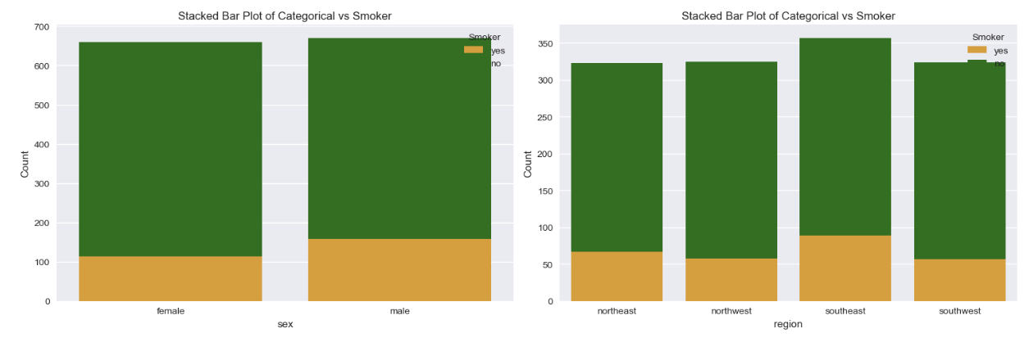
Gender, Region Vs Smoker
Comparative other regions southeast region has more smokers.
Almost same number of smokers in each gender, but comparative males are more.

Slide 17
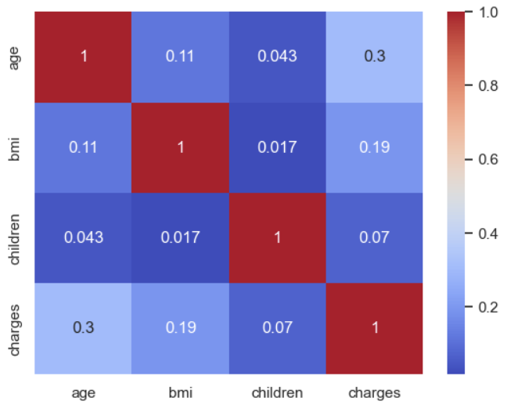
Correlation of Numerical Columns
There is no specific correlation between any two numeric columns.
They have Positive correlation with each other but not strong correlation.

Slide 18
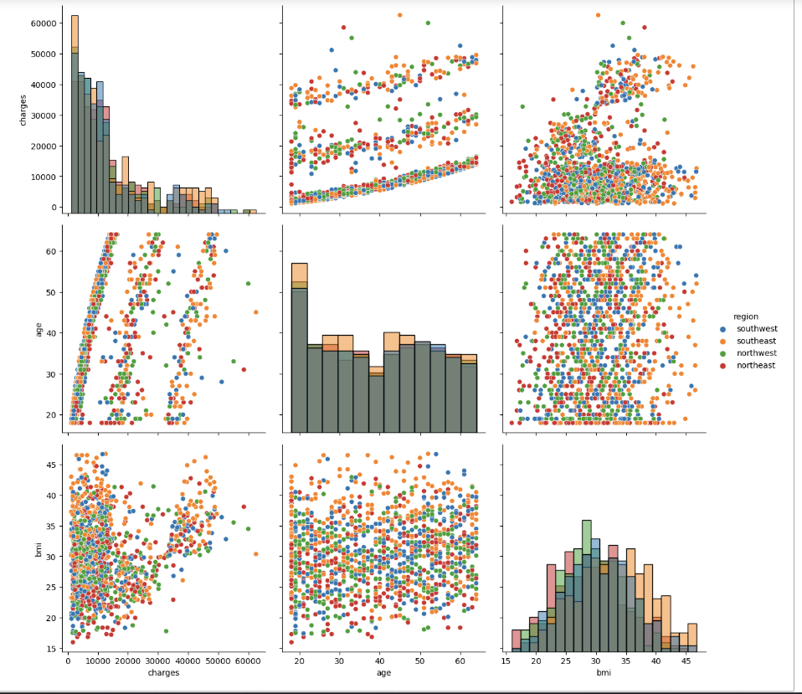
Age, Bmi and Region Vs Charges
The higher age with high BMI patients are from southeast region who have higher medical expenses.
It indicates that southeast region patients tend to have more health issues.
Further, southeast region has more smoker patients than the other regions.

Slide 19
Conclusion and Recommendations
This data set includes information on patients from all age groups and their bmi provides valuable insights that health care insurance company can consider as an important features for assessing risk profiles and determining appropriate coverage premiums.
By analysing bmi information, insurer can better assess the health risks and provide customize coverage premiums. Insurer can consider who has underweight that their bmi will be less than18.5 because they have also the health risks that may cause medical expenses more.
Insurer can introduce new strategies to fix premium for female members of health insurance.
Insurer can introduce interested premiums in southeast region which has more high-risk patients with higher age, higher count of smokers and higher bmi.
Instead of giving more premiums to non-smokers who have more in count, Insurer should concentrate on smokers who are considered as higher risk patients as well as those who have more medical expenses even though the count of smokers is less.

Slide 20

THANK YOU

